Slide 1
Rural Health Transformation Program (RHTP)
Informational Webinar
September 15, 2025

Slide 2
Webinar Agenda
RHTP Background
Rural Health in Maryland Overview
Request for Information and Community Listening Sessions
Program Timeline
Q&A

Slide 3
RHTP Background

Slide 4
Creation of the Rural Health Transformation Program (RHTP)
H.R. 1 (The One Big Beautiful Bill Act, “OBBBA”) was signed into law in July 2025.
OBBA created the Rural Health Transformation Program (RHTP).
Centers for Medicare & Medicaid Services (CMS) will administer the program.

Slide 5
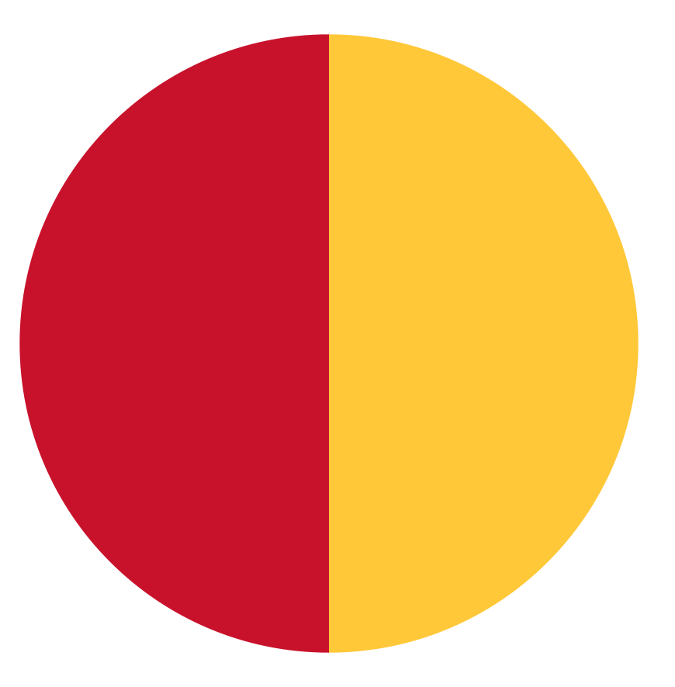
Funding of the Rural Health Transformation Program (RHTP)
$50 billion to 50 states over 5 years
If the state’s application is successful, Maryland could expect to receive at least $100 million annually
Funds will be distributed from 2026-2030
$25B:
Distributed based on rurality, quality of application, and state policy
$25B:
Distributed equally among all states with approved applications

Slide 6
Sustainability of Efforts
H.R. 1 provides RHTP funds for 5 years.
It will be important to think about the sustainability of ideas and proposals and what will require ongoing funding, as compared to efforts that require only initial support.

Slide 7
RHTP Strategic Goals
CMS has outlined the following strategic goals for the use of the Rural Health Transformation Program (RHTP):
Make Rural America Healthy Again
  Prevention and management of chronic disease
  Behavioral Health
Sustainable Access
Workforce Development
Innovative Care
Tech Innovation
More information can be found on the CMS RHTP webpage.

Slide 8
RHTP: Uses of Funds
“States must use RHT Program funds for three or more of the approved uses of funds:
Promoting evidence-based, measurable interventions to improve prevention and chronic disease management.
Providing payments to health care providers for the provision of health care items or services, as specified by the Administrator.
Promoting consumer-facing, technology-driven solutions for the prevention and management of chronic diseases.
Providing training and technical assistance for the development and adoption of technology-enabled solutions that improve care delivery in rural hospitals, including remote monitoring, robotics, artificial intelligence, and other advanced technologies.
Recruiting and retaining clinical workforce talent to rural areas, with commitments to serve rural communities for a minimum of 5 years.”
More information can be found on the CMS RHTP webpage.

Slide 9
RHTP: Uses of Funds (Continued)
“Providing technical assistance, software, and hardware for significant information technology advances designed to improve efficiency, enhance cybersecurity capability development, and improve patient health outcomes.
Assisting rural communities to right size their health care delivery systems by identifying needed preventative, ambulatory, pre-hospital, emergency, acute inpatient care, outpatient care, and post-acute care service lines.
Supporting access to opioid use disorder treatment services (as defined in section 1861(jjj)(1)), other substance use disorder treatment services, and mental health services.
Developing projects that support innovative models of care that include value-based care arrangements and alternative payment models, as appropriate.
Additional uses designed to promote sustainable access to high quality rural health care services, as determined by the Administrator.”
More information can be found on the CMS RHTP webpage.

Slide 10
Notice of Funding Opportunity (NOFO)
The NOFO was released on 9/15.
The NOFO outlines the points system that will be used. Proposals will receive points based on the initiative being proposed (ex: outcomes), intended state policy actions, and the “workload” (ex: rurality of the state).
The NOFO has a list of example initiatives that aligns with CMS’ strategic goals.

Slide 11
Definition of Rural
There are many different definitions of “rural.” The NOFO says the applicant should “Describe the specific criteria or data that your State uses to identify rural areas in this application.”
Maryland identifies 18 counties as rural:
  Allegany, Calvert, Caroline, Carroll, Cecil, Charles, Dorchester, Frederick, Garrett, Harford, Kent, Queen Anne’s, St. Mary’s, Somerset, Talbot, Washington, Wicomico, and Worcester.
The NOFO states that CMS will use “The number of people in the State located in a rural area is based on the most recent version of the rural definition maintained by HRSA” in determining the discretionary budget. HRSA defines rural Maryland as:
  Full Counties - Allegany, Caroline, Dorchester, Garrett, Kent, Queen Anne’s, Somerset, Talbot and Worcester
  1 Census Tract in each of these counties - Calvert, Carroll, Charles

Slide 12
Overview: Rural Health in Maryland

Slide 13
Rural Maryland Demographics
Western Maryland: Allegany, Garrett, and Washington. Northern Maryland: Harford, Carroll, and Frederick. Southern Maryland: Charles, Calvert, and St. Mary’s. Eastern Shore Maryland: Cecil, Caroline, Dorchester, Kent, Queen Anne’s, Somerset, Talbot, Wicomico, and Worcester.
FEATURES | POPULATION | % 65+ YEARS | % NON-WHITE RACE | % HISPANIC ETHNICITY | % POVERTY | MEDIAN HOUSEHOLD INCOME | % BACHELORS DEGREE OR HIGHER | % MEDICAID COVERAGE
DATA OBTAINED | 2024 | 2024 | 2024 | 2024 | 2021 | 2019-2023 | 2019-2023 | 2023
United States of America | 333,287,557 | 16.8% | 24.2% | 18.9% | 11.6% | $69,021 | 33.7% | 18.9%
State of Maryland (total) | 6,164,660 | 17.3% | 42.8% | 12.6% | 9.5% | $101,652 | 42.7% | 19.5%
State-Designated Rural | 1,820,142 | 17.1% | 21.4% | 5.1% | 10.8% | $70,423 | 28.0% | 18.8%
Western Maryland | 252,718 | 21.0% | 11.9% | 4.0% | 13.7% | $66,860 | 23.1% | 20.0%
Northern Maryland | 741,939 | 16.6% | 19.0% | 8.1% | 6.7% | $115,884 | 41.4% | 15.6%
Southern Maryland | 385,860 | 15.3% | 35.8% | 6.7% | 7.0% | $122,410 | 34.0% | 17.3%
Eastern Shore Maryland | 471,087 | 22.5% | 23.6% | 6.5% | 13.0% | $77,435 | 28.7% | 20.1%
United States Census Bureau. Quick Facts Maryland. https://www.census.gov/quickfacts/fact/table/MD/PST045224

Slide 14
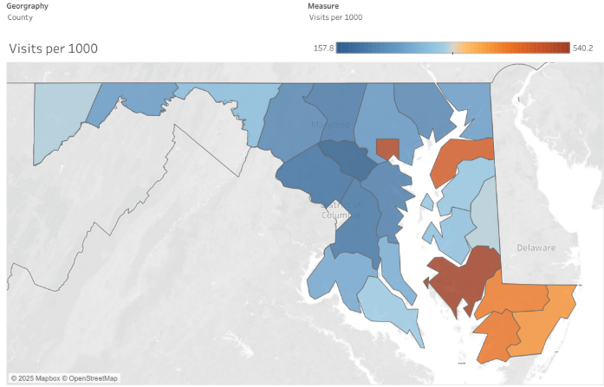
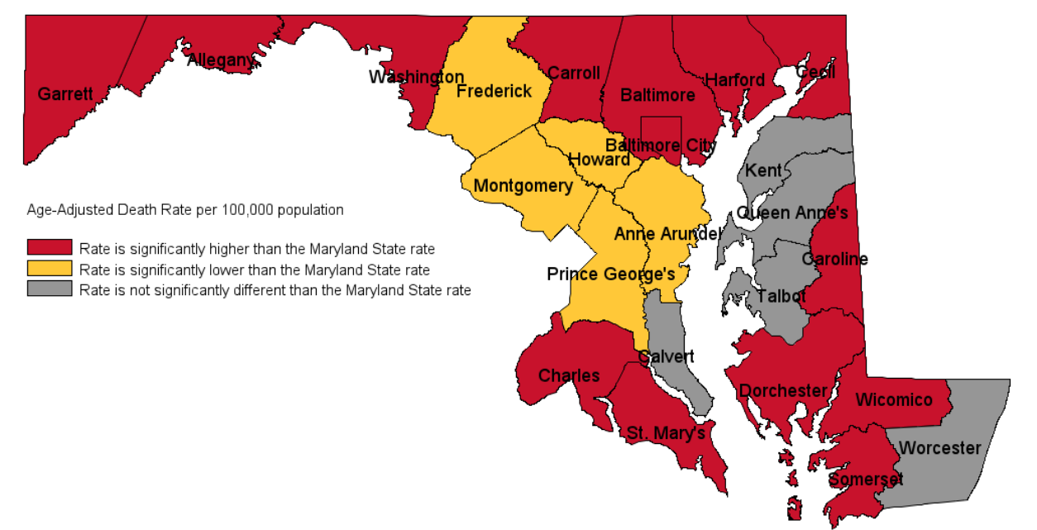
Maryland Rural Health: Top Line Utilization and Mortality Rates
ED Visits per 1000 Residents for All Conditions
Age-Adjusted Death Rates for All Causes, Compared to Maryland State Rate
Vital Statistics Annual Report, 2022.
CRISP Public Health Dashboard, June 2024 to June 2025.

Slide 15
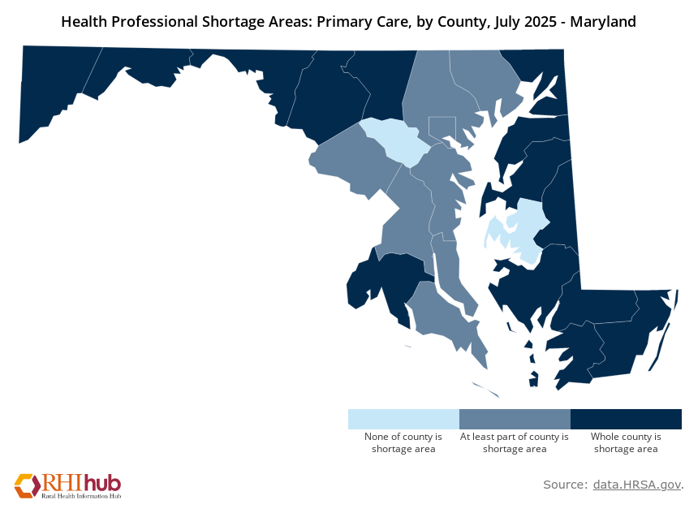
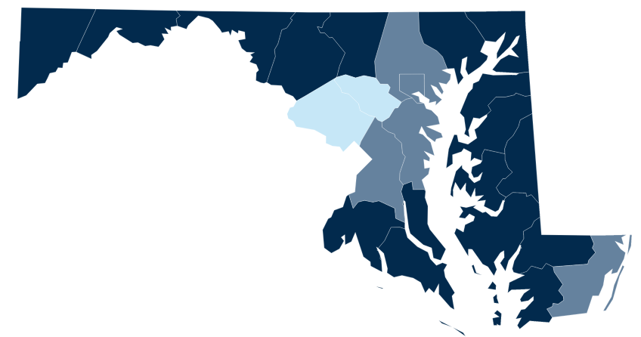
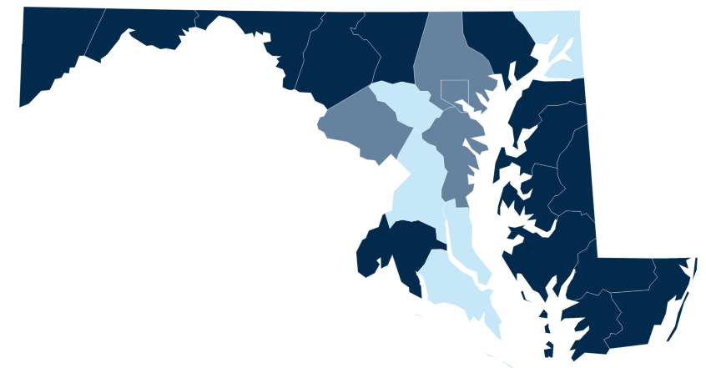
Maryland Rural Health: Workforce Shortage Areas
Federally Designated Health Professional Shortage Areas, July 2025
Primary Care
Mental Health
Dental Health

Slide 16
Impact of H.R.1 on Marylanders
More than 190,000 rural Marylanders are covered by Medicaid.
Approximately 175,000 Marylanders are estimated to lose Medicaid coverage and Maryland Medicaid will lose up to $2.7 billion in federal funding.
More Marylanders will become uninsured and pay higher costs for insurance due to changes to the ACA Marketplace.

Slide 17
Request for Information
and
Community Listening Sessions

Slide 18
MDH Request for Information (RFI)
Maryland is accepting ideas, projects, and approaches through an online survey, which is available on the MD State Office of Rural Health website.
You may also submit your response to the questions in the following ways:
Email: mdh.transformruralhealth@maryland.gov
Mail: Maryland State Office of Rural Health, Maryland Department of Health, 201 West Preston Street Baltimore, MD 21201 ​
Submissions are due by September 30.

Slide 19
RFI Survey Overview
The RFI survey is an opportunity for you or your organization to provide an overview of a project, concept, or approach that could help transform rural health. MDH is open to receiving descriptions of existing projects that could be scaled up, new projects that are ready to launch in the near future, and ideas that could be used to develop future projects.
The RFI is for planning and information gathering purposes. No contracts or grants will be awarded on the basis of survey responses. A formal Request for Proposals or grant application process may follow at a later date. We may reach out to you for further information about your idea.

Slide 20
RFI Questions
Name
Email address
Organization (write “NA” if you are not affiliated with an organization)
What part of rural Maryland are you from or do you serve?
Provide a high-level summary of your project, concept or approach to improve rural health in Maryland.
In which geographic areas would your idea address rural health needs?
What challenges to rural health would your project idea address?
What are the expected impacts of your project?
List any partners or collaborators who would be needed to implement your idea.
How does your idea align with the RHTP focus areas and allowable activities?
If your organization is ready to launch this project in the near-term, please answer the following questions.
What is your organization’s experience with rural health?
Is this an existing model or program that could be scaled or expanded?
What is your readiness to implement this project? What would you need to implement this project?
Please provide a general timeline for implementation.
Please provide an anticipated budget.
How would you ensure sustainability of this program?
How would we analyze and understand the impact of this program?

Slide 21
Local Listening Sessions
During the month of September, listening sessions will be held in rural communities to understand community needs and collect ideas and recommendations.
Dates and locations will be posted on the State Office of Rural Health RHTP webpage.

Slide 22
Who Should Provide Input?
We welcome input from rural Marylanders and those who serve them. This includes, but is not limited to:
Rural residents
Community-based organizations
Hospitals and health systems
Federally qualified health centers and community clinics
Health care professionals and networks - from primary care to specialty care
Post-acute providers, including skilled nursing and assisted living facilities
Behavioral health professionals
Educational institutions and health care workforce programs
Local government agencies/departments
Local elected officials

Slide 23
Program Timeline

Slide 24
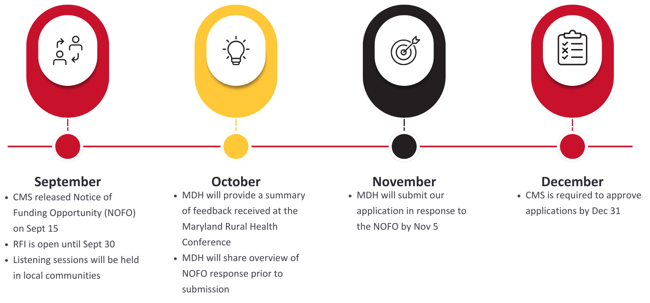
RHTP Timeline

Slide 25
Questions?
Reach out to MDH at: mdh.transformruralhealth@maryland.gov

Slide 26
Q&A

