Slide 1
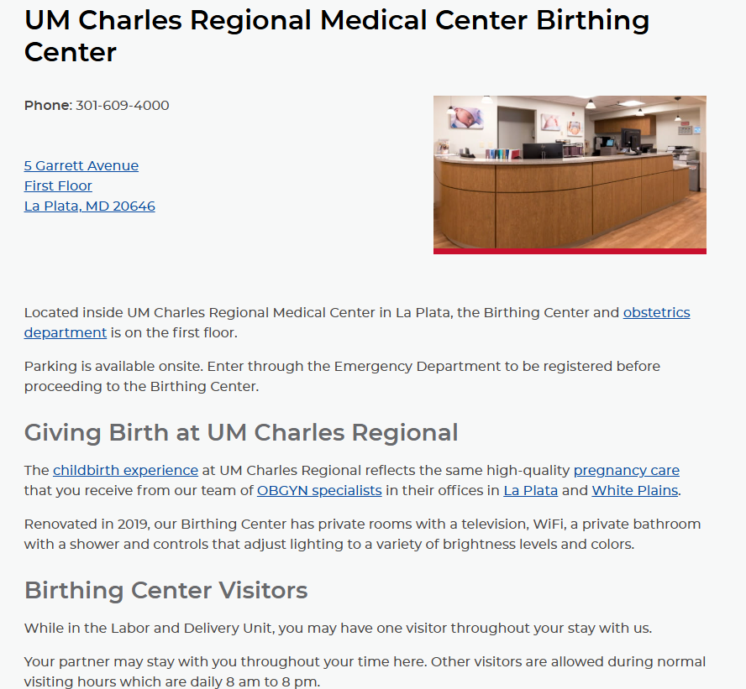

Slide 2
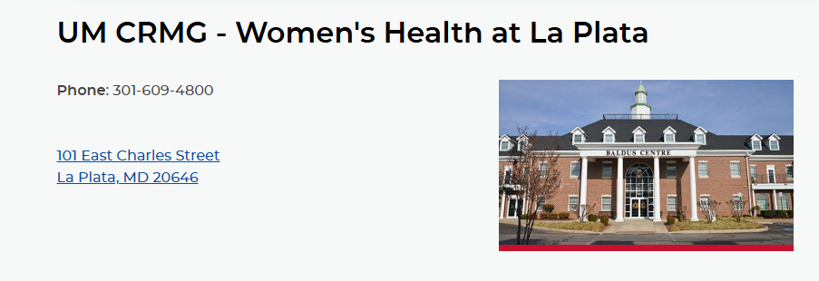
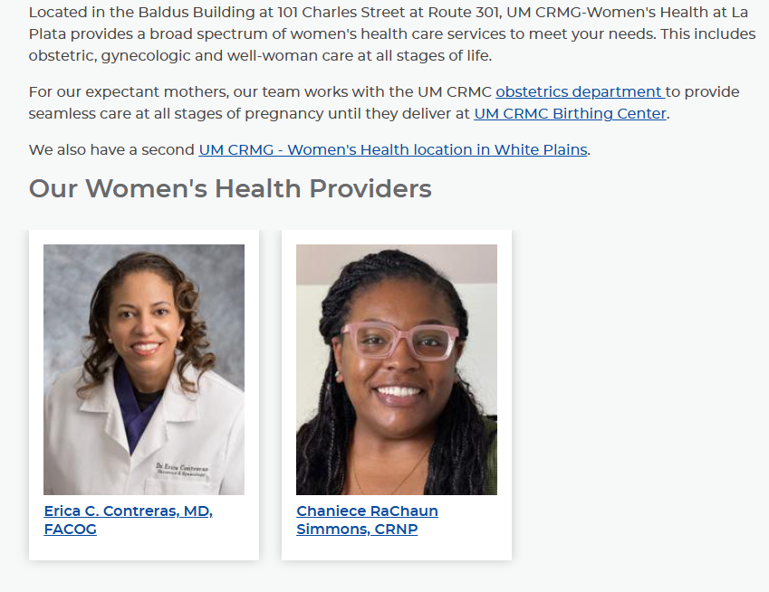

Slide 3
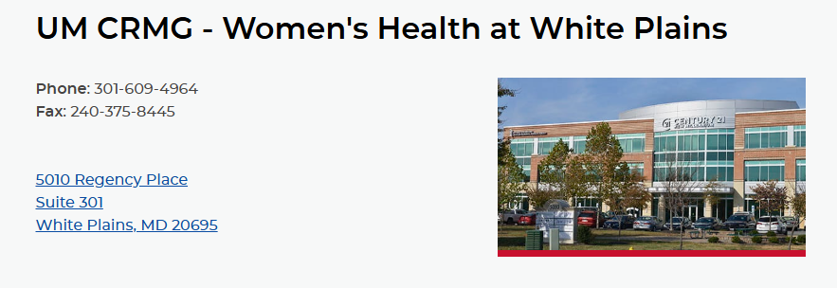
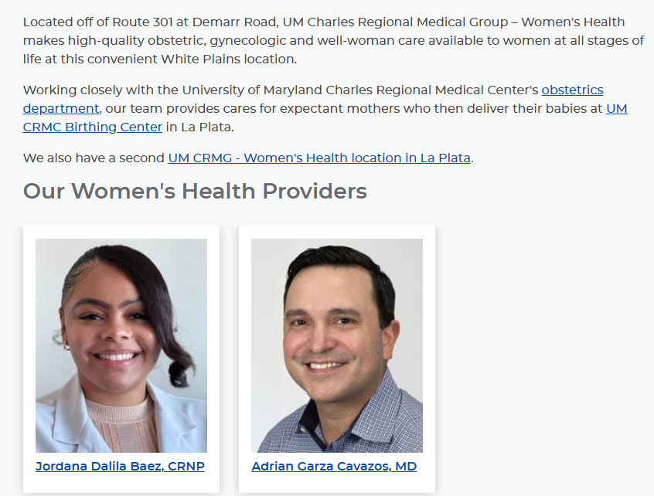

Slide 4
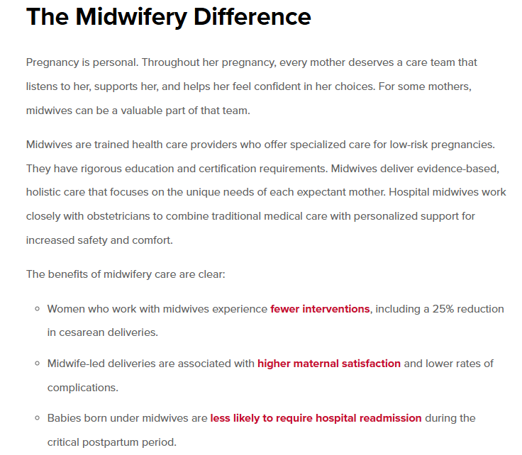
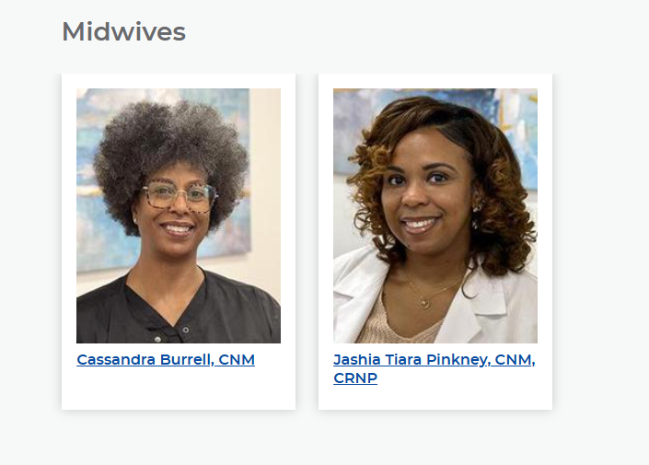
Midwifery Program at Charles Regional

Slide 5
Hypertension Management
In 2023, MDPQC implemented the “Severe Hypertension in Pregnancy” patient safety bundle. This bundle is part of a national effort to improve maternal health outcomes focusing on recognizing, preventing, and responding to severe hypertension in pregnant individuals, which is a leading cause of preventable complications and deaths during pregnancy.
Key Components
Readiness: Ensuring that healthcare teams are prepared to identify and manage severe hypertension effectively.
Recognition & Prevention: Training providers to recognize signs of severe hypertension early and implement preventive measures to mitigate risks.
Response: Establishing protocols for immediate response to hypertensive crises, including medication administration and monitoring.
Reporting/Systems Learning: Creating systems for reporting incidents and learning from them to improve care processes continuously.
Respectful Care: Incorporating respectful and equitable care practices to address disparities in maternal health outcomes, particularly among marginalized populations.

Slide 6
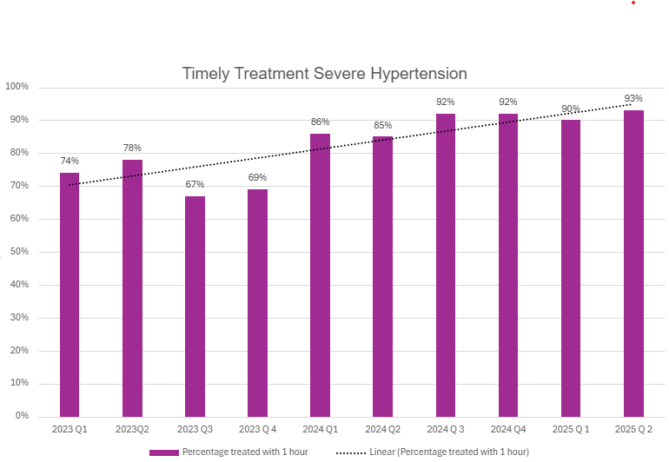
HYPERTENSION MANAGEMENT
Educated all providers (Nurses and Physicians) on signs and symptoms of hypertensive disorders in pregnancy
Implemented standardized protocol for measuring, assessing, and treating hypertension in pregnancy and postpartum
Increase in the number of simulated/drills centered around severe hypertension and preeclampsia
Timely treatment of hypertension at CRMC increased from 67% to 93% over the past two years
Charity BP monitors distributed as appropriate

Slide 7
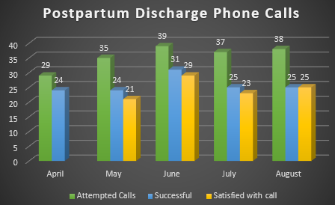
Post Discharge Calls
178 total patient calls since April 2025
129 successful phone calls
26 referrals made
5 billing
13 doctor’s office (Obstetrician/Pediatrician)
8 lactation
98 out of 105 satisfied with phone call

Slide 8
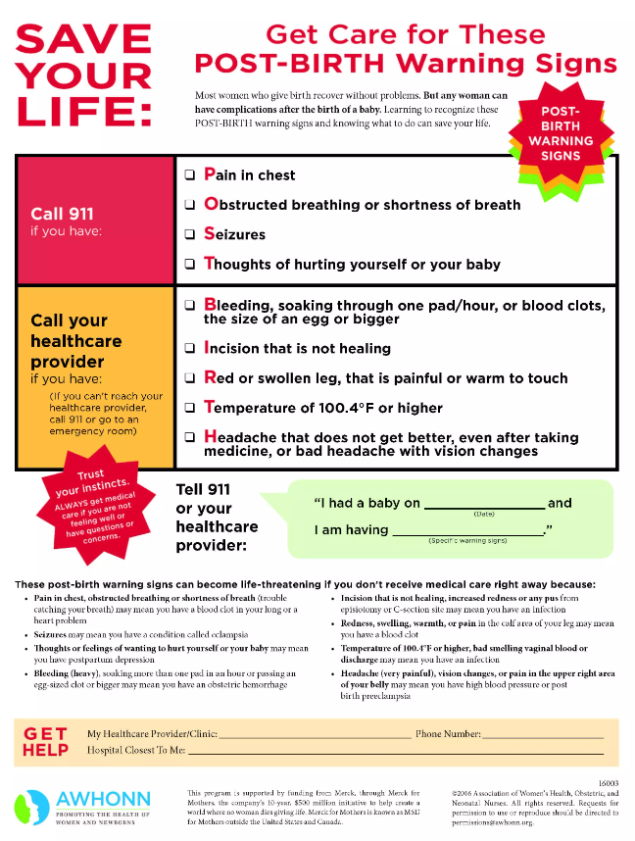
POST DISCHARGE CALLS
Goal is to follow up within 24-48 hours after discharge
Three attempts to contact patient
Follow script
How are you feeling overall?
Any severe postpartum warning signs?
Have they made postpartum follow up appt?
How's baby doing? Eating well?
Have they made first appt for newborn?
Any questions or concerns?
Satisfaction with post discharge call
Document encounter in chart
Automated NRC calls/text/emails also provide a more general health survey for the patient

Slide 9
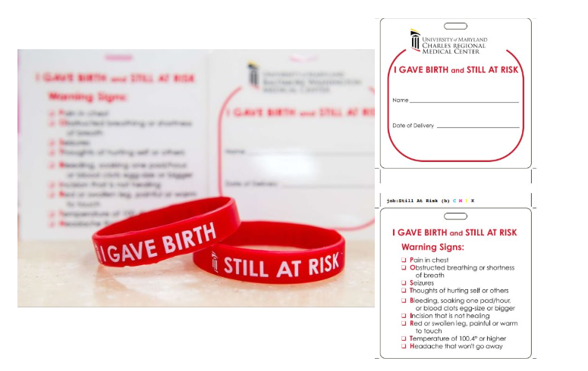
“I Gave Birth” Bracelets and Severe Maternal Warning Signs
“I Gave Birth” bracelets are given to individuals who recently delivered to improve care during the postpartum period
The bracelets aim to help health care providers, and the community better identify new mothers and understand potential postpartum complications within the first year
Given at discharge and are encouraged to wear for one year
Diaper bag tags are also given that list postpartum warning signs

Slide 10
“I Gave Birth” Bracelets and Severe Maternal Warning Signs
“I Gave Birth” bracelets are given to individuals who recently delivered to improve care during the postpartum period
The bracelets aim to help health care providers, and the community better identify new mothers and understand potential postpartum complications within the first year
Given at discharge and are encouraged to wear for one year
Diaper bag tags are also given that list postpartum warning signs

Slide 11

Contacts
Edith Kratzer
edith.kratzer@maryland.gov
Mary Hannah
mhannah@umm.edu
Valerie Dent
valerie.dent@maryland.gov
Jennifer Wood
jwood@umm.edu
Mary Levy
mary.levy@umm.edu

