Slide 1
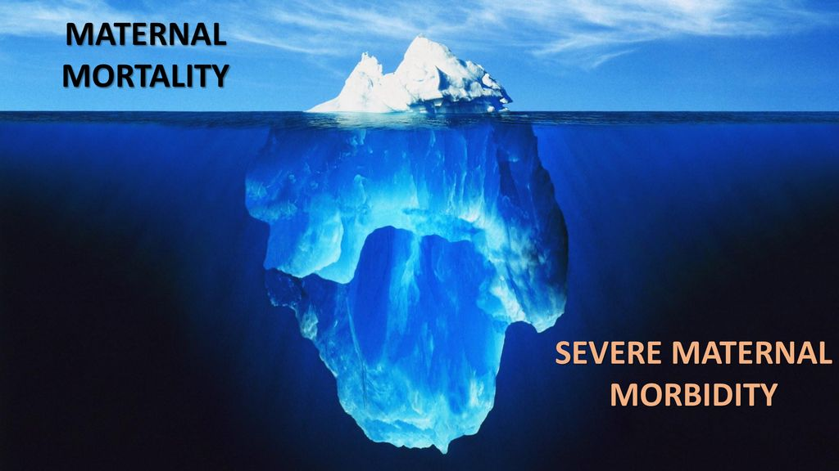
Severe Maternal Morbidity (SMM)

Slide 2
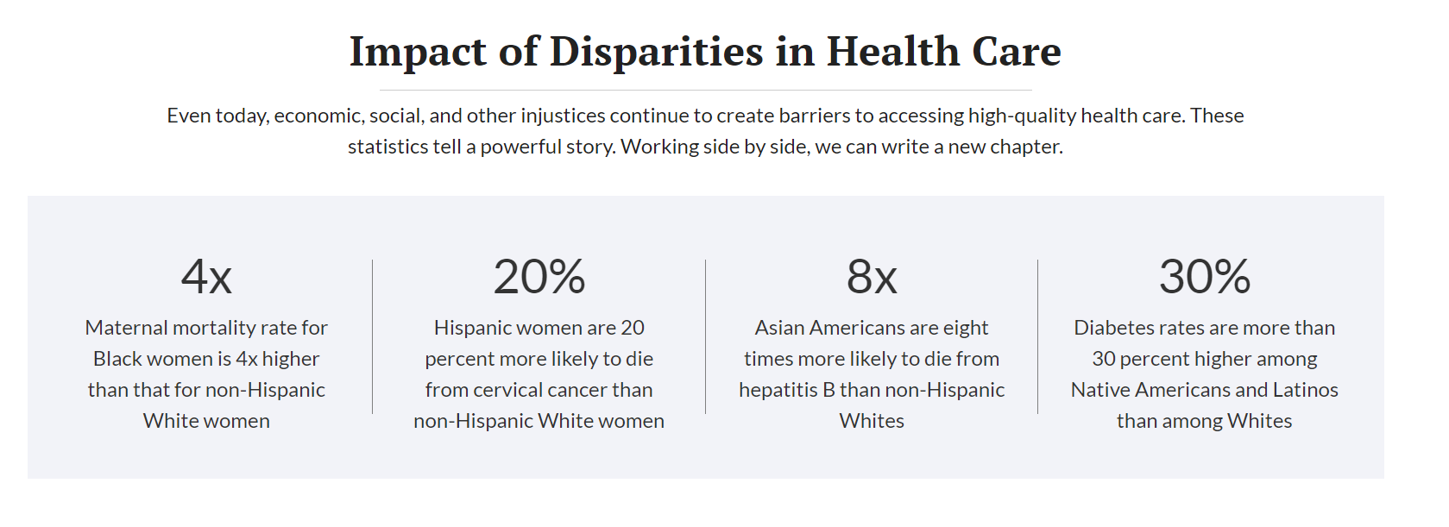


Slide 3
Charles County Fetal and Perinatal Mortality Trends
Source: Maryland Annual Vital Statistics Reports

Slide 4
Why such a rapid decline in 2018?
Charles Regional Medical Center joined the Maryland Perinatal-Neonatal Quality Collaborative (MDPQC) June 2016
From 2016-2018 MDPAC launched “Safely Reduce Primary Cesarean Sections” using a complex AIM patient safety bundle
  Structured way of improving the processes of care and patient outcomes. Patient safety bundles are collections of evidence-informed best practices, developed by multidisciplinary experts.
  The goal of PSBs is to improve the way care is provided to improve outcomes
The collaborative focused on reducing cesarean deliveries in the NTSV population, which includes low-risk, first-time mothers
Nulliparous- 1st time mom
Term- >37 weeks
Singleton-1 baby
Vertex- Head down

Slide 5
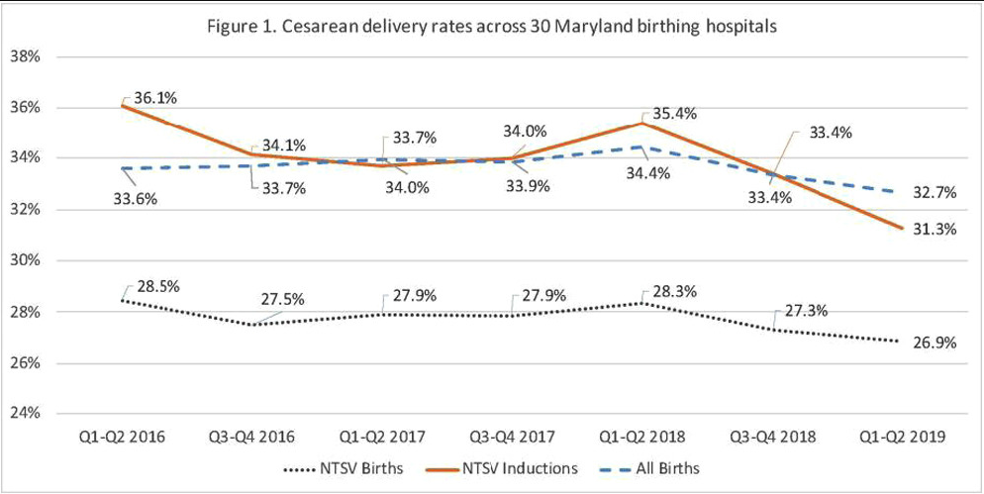
Results:
Initial rate: The NTSV cesarean delivery rate for participating Maryland hospitals was 28.5% at the beginning of the collaborative in 2016, which was higher than the national average.
Reduced rate: After implementing the AIM bundle, the rate decreased to 26.9% among all NTSV births. This represents a significant reduction and resulted in 470 avoided C-sections at participating hospitals over a two-year period.
The rates also saw significant drops for induced NTSV births, decreasing from 36.1% to 31.3%.

Slide 6
Why is this important?
Cesarean sections have an increased maternal risk including postpartum hemorrhage, hysterectomy, need for further surgery, transfusion, venous thromboembolism and major puerperal infection.
There is also increased risk of placenta previa, placenta accreta, stillbirth and uterine rupture in later pregnancies.

Slide 7
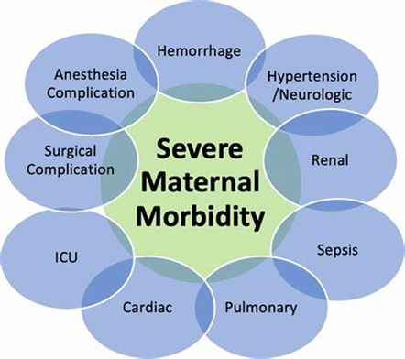
Severe maternal morbidity (SMM) includes unexpected outcomes of labor and delivery that can result in significant short- or long-term health consequences. SMM has been steadily increasing in recent years.

Slide 8
SMM Diagnoses List – 21 Indicators
Acute Myocardial Infarction
Aneurysm
Acute Renal Failure
Acute Respiratory Distress
Amniotic Fluid Embolism
Cardiac Arrest / V Fibrillation
Conversion of Cardiac Rhythm
Disseminated Intravascular Coagulation
Blood Transfusion
Eclampsia
Heart Failure
Puerperal Cerebrovascular Disorders
Pulmonary Edema
Severe Anesthesia Complications
Sepsis
Shock
Sickle Cell Disease With Crisis
Air and Thrombotic Embolism
Hysterectomy
Temporary Tracheostomy
Ventilation

Slide 9
Equity Gaps in Severe Maternal Morbidity
UM Charles Regional Medical Center (UM CRMC)
University of Maryland Medical System (UMMS)
Severe Maternal Morbidity (SMM) Rate
Stratified by Race and Ethnicity, CY21-24
Target 1.97%
Target 1.97%

Slide 10
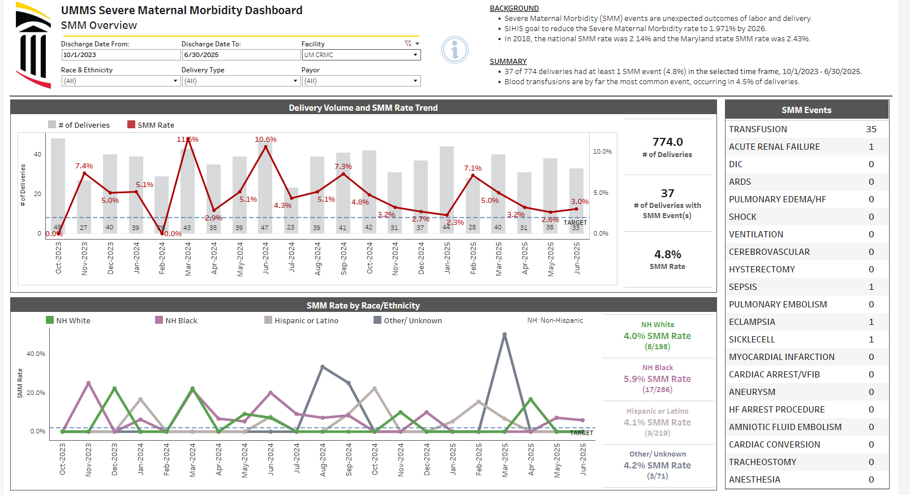
SMM Data from the UMMS EPC Dashboard

Slide 11
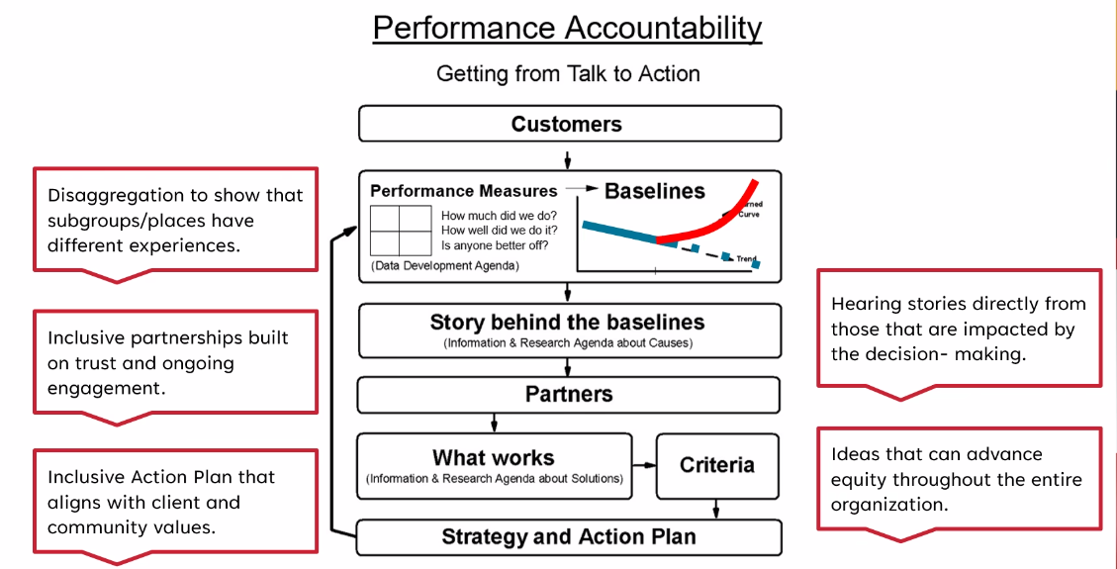
Turn the Curve Thinking

Slide 12
Story Behind the Data
Prioritized Factor # 1
01
Addressing anemia as a preexisting condition
Performance Metric
Eliminate racial disparities in Severe Maternal Morbidity
Prioritized Factor # 2
02
Lack of receiving or understanding education by birthing parents about their current medical needs
03
Prioritized Factor # 3
Transportation resources

Slide 13
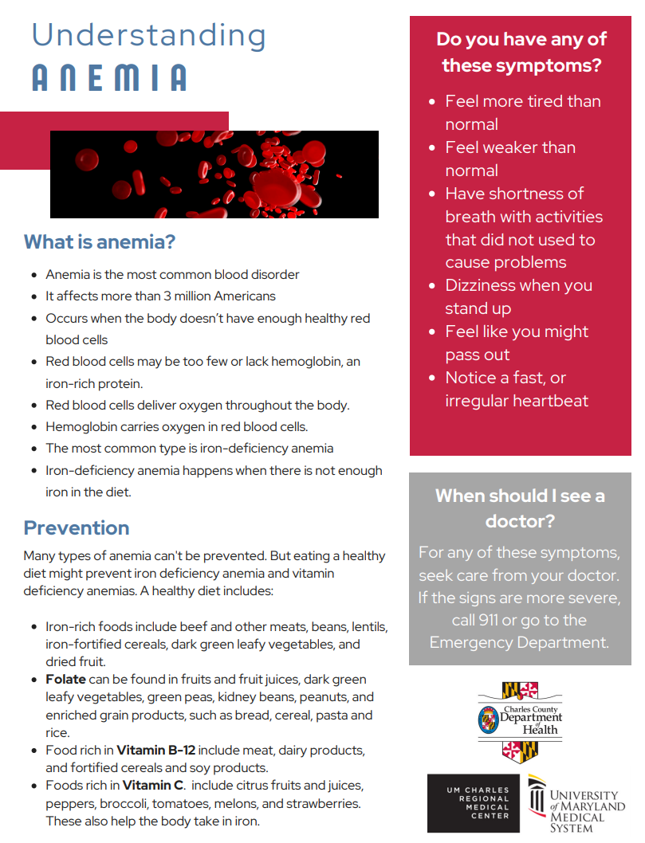
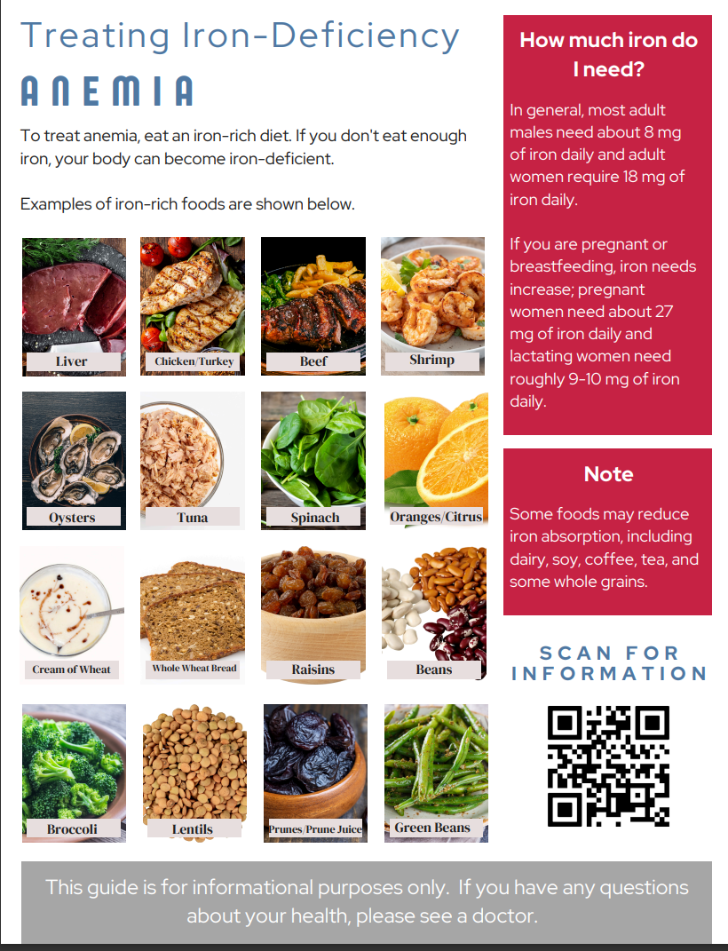
Anemia Education

Slide 14

ANEMIA EDUCATION
https://umms.healthclips.com/Asset/View/WN10455/anemia

