Slide 1


Maternal & Child Health Charles County
Charles County Department of Health
Fetal, Infant Mortality Review, Community Action Team
and Babies Born Healthy
University of Maryland Charles Regional Medical Center
2025 SMM Health Equity Transformation
Maternal Mortality and Morbidity Prevention
September 17th, 2025

Slide 2
AGENDA
Introduction
Connect to Purpose:
Ashley O’Neil’s Story
Maternal Child Health-Primary Goals
Babies Born Childbirth, Positive Parenting & Infant Safety
Brittney’s Story
FIMR Focus/Overview
Doula Services
Severe Maternal Morbidity

Slide 3

Ashley O’Neil, CRNP, is a nurse practitioner, writer, and speaker whose advocacy is rooted in lived experience. As a NICU/preemie mother, a widow, and a bereaved parent, Ashley brings a deeply personal perspective to maternal and neonatal health. With over a decade in nursing and five years as a family nurse practitioner, she now uses her voice to elevate the needs of NICU families, offering practical resources, compassionate support, and hope. She is the author of It’s a NICU World, a children’s book, and It’s a NICU World: Your Guide During Your Baby’s NICU Stay, a resource designed to support and empower NICU parents. Ashley also hosts the Ask a NICU Mama podcast, where she candidly explores the emotional and medical complexities of life in and after the NICU. Through her work, Ashley is committed to ensuring families feel seen, supported, and empowered, even in their most vulnerable moments.

Slide 4
Maternal Child Health PRIMARY GOALS
Reproductive Health and Babies Born Healthy services collaborate to help clients establish a long-term pregnancy life plan to empower residents to choose an appropriate family planning method, to connect to needed services, to ensure health care will continue, and to address any unhealthy lifestyle choices.
HEALTHY BIRTHING PARENT=HEALTHY BABY

Slide 5
Babies Born Healthy
The BBH Program is a gateway to many services within Charles County. Pregnant birthing parents are afforded an opportunity to have pregnancy testing and confirmation through the Health Department. Birthing parents can walk-in for pregnancy testing or are referred by internal or external partners. Pregnancy is determined and services are offered All reproductive health services are completely voluntary. Pregnancy navigation and case management begins at diagnosis of pregnancy and goes up to the first year of life.

Slide 6
Babies Born Healthy program was created to help expecting parents access healthcare, healthy foods and health education
Some of our services include:
Assisting with access to insurance for the birthing parent and the baby
Helping connect to obstetrical care
Assisting with access to WIC services
Connection to Behavioral Health Services and Dental Care
Connection to transportation resources for transport to prenatal care services
Durables (pack n play, stroller or car seat)
Childbirth, positive parenting and infant safety classes
Car seat installation

Slide 7

Brittney’s Story

Slide 8
Childbirth, positive Parenting & infant safety
Classes are held the last Tuesday of every month
Held at the Health Department
Outside resources are welcome to attend to provide resources

Slide 9

UM Charles Regional Safe Sleep Education
Safe Sleep Act 2024
Mandates hospitals to provide resources and information about safe sleep environments to parents and guardians of infants before discharge
January 2025 - Started safe sleep education at discharge
February 2025 - Developed safe sleep acknowledge form with video
March - Developed safe sleep resource form to add to discharge folders
June 2025 - Started handing out Halo swaddle sacs at discharge
100% of infants discharged since January 2025 have received safe sleep education

Slide 10
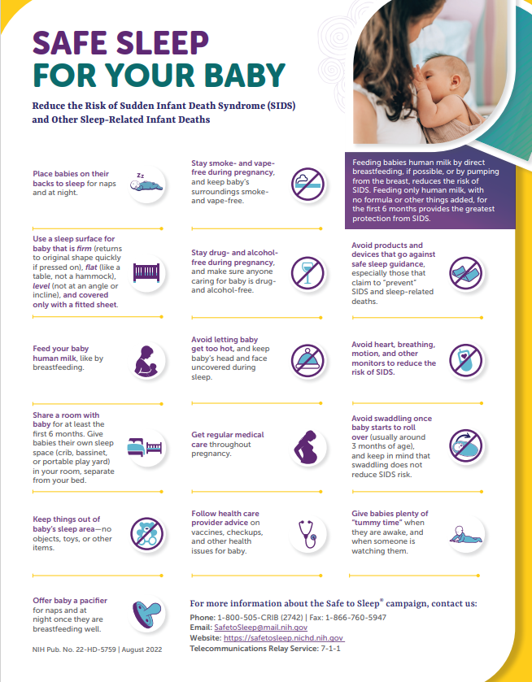
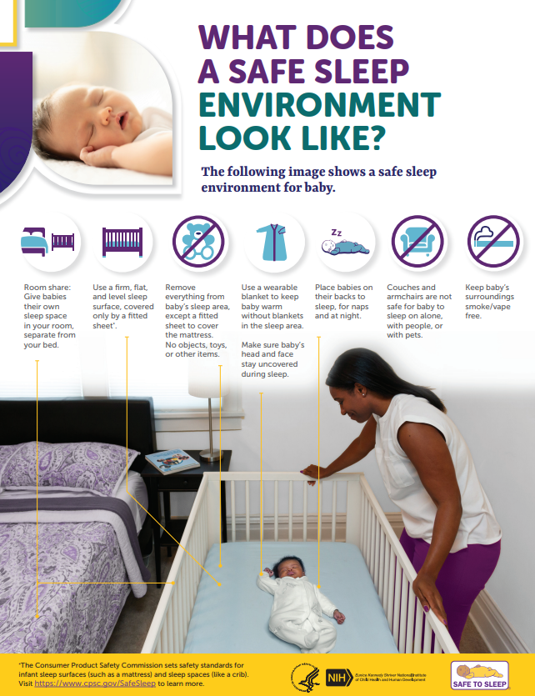

Slide 11
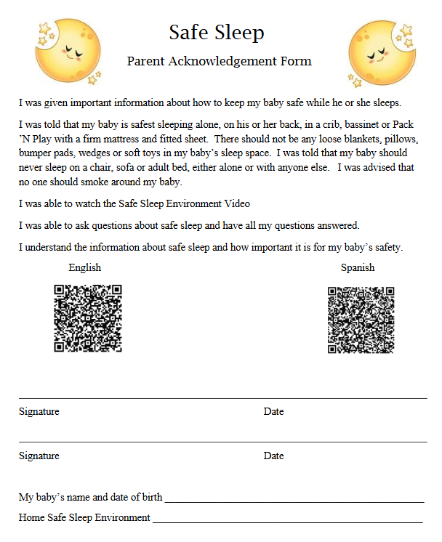
Safe Sleep Education

Slide 12
Fetal Infant Mortality Review/child fatality review

Slide 13
Priorities
Reduce sleep -related infant deaths
Enhance data quality for SUID cases through participation in CDC Case Registry activities
Develop recommendations addressing racial disparities in child death

Slide 14
FIMR/CFR Focus
FIMR/CFR: Is a process communities use to examine fetal, infant and child deaths
FIMR/CFR: Enhances the understanding of local factors that play a role in the circumstances preceding death
FIMR/CFR: Helps to identify needed system changes and motivates actions
6 Major factors affecting fetal, infant and child deaths in Maryland:
Prematurity
Low birth weight
Congenital abnormalities
Sudden Unexpected Death in Infancy (SUID)
Maternal complications of pregnancy
Cardiovascular disorders

Slide 15
FIME/CFR Focus
At the Center for Fatality Review & Prevention, we envision a Maryland where preventable child fatalities will be eliminated. Maryland Child Fatality Review Teams were established by the Maryland General Assembly in 1999. Child Fatality Review (CFR) is a systematic, multiagency, multidisciplinary review of unexpected child deaths within a jurisdiction. We appreciate the time and effort of CFR team members and their dedication to the review of cases of unexpected child death for the purpose of developing an understanding of the causes and incidence of child deaths and developing recommendations and implementing interventions to prevent future child deaths.
Examples of Community Action Team (CAT) recommendations and interventions implemented: crosswalks, drug screening in OB/GYN offices, and traffic lights at intersections with increased accidents.

Slide 16
Doula Services
In 2024, research highlighted positive associations between doula care and improved maternal outcomes, such as a 47% lower risk of cesarean delivery and 29% lower risk of preterm birth in Medicaid-enrolled women, according to an American Journal of Public Health study (November 2024).
Policy also saw significant growth, with seven new states implementing Medicaid coverage for community-based doulas and increased reimbursement rates.
These trends reflect increased recognition of doula support as an evidence-based strategy to address maternal health disparities and improve care for low-income families, though cost remains a barrier for private care.

Slide 17
Doula Services
Other benefits documented include increase attendance at postpartum checkups and a higher likelihood of spontaneous vaginal birth.
Doula care can be a cost-effective intervention, with studies suggesting potential savings for states and managed care organizations.
Reductions in costs associated with preterm births and cesarian sections contribute to these potential savings.
Doula care is recognized as a key strategy for addressing the high rates of maternal morbidity and persistent health disparities in the US.

Slide 18
Doula Services
Doula Services are a Community Partnership within Charles County that has broadened the scope of practice to decrease maternal morbidity and mortality rates within the County.
The Charles County Department of Health has been awarded a direct service doula grant, from the State of Maryland, in conjunction with Babies Born Healthy, for those at greatest risk of poor birth outcomes within our community.
Doula Introductions: Meet our Doulas!

